Slide 1
I have a new friend.
Unit 6
Lesson Five – Skills Time

Slide 2
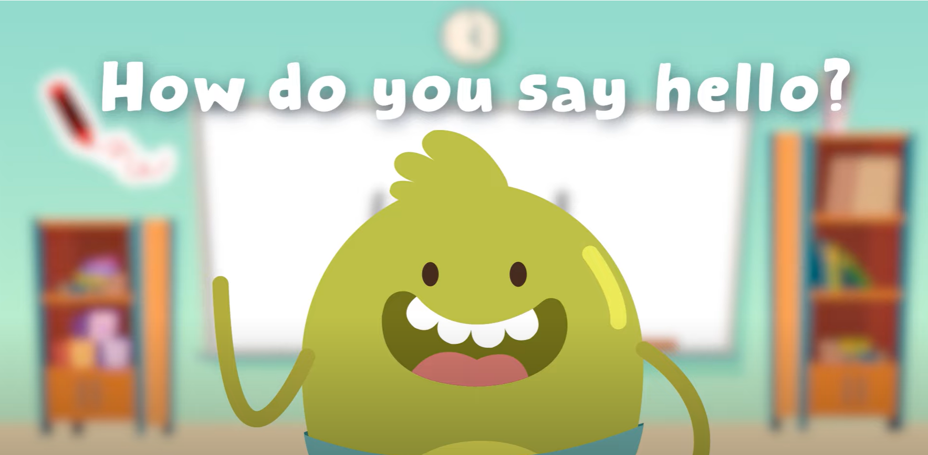
Hello Song

Slide 3


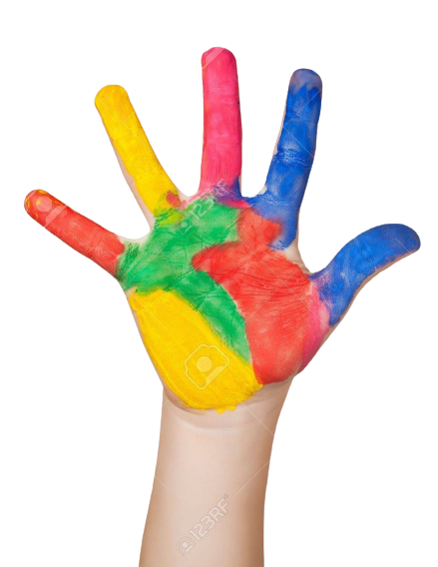



Give me FIVE

Slide 4
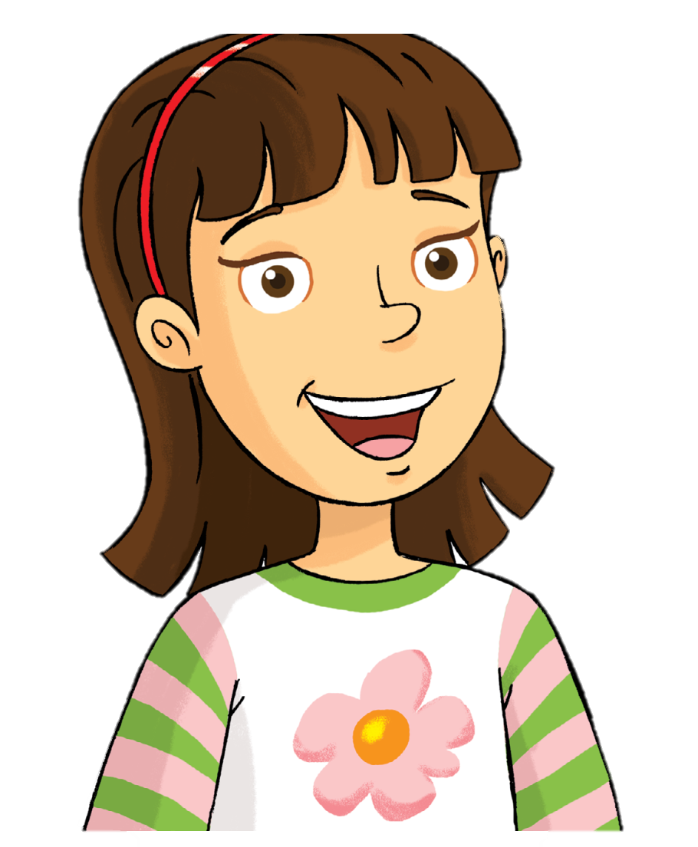
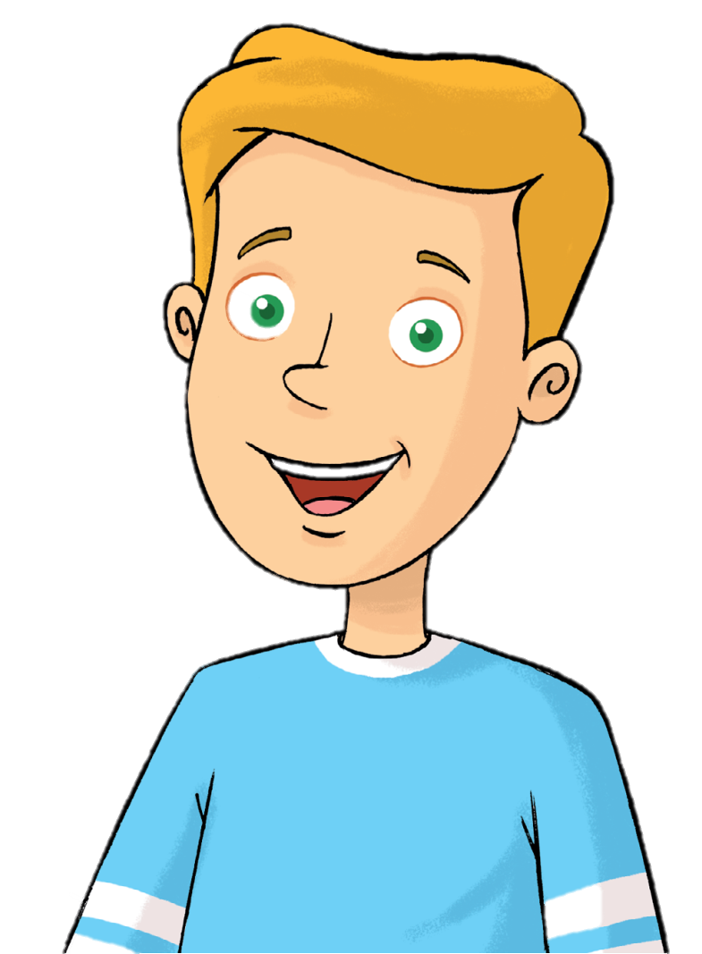
Look and Say
Rosy
Tim

Slide 5

Watch and Answer

Slide 6
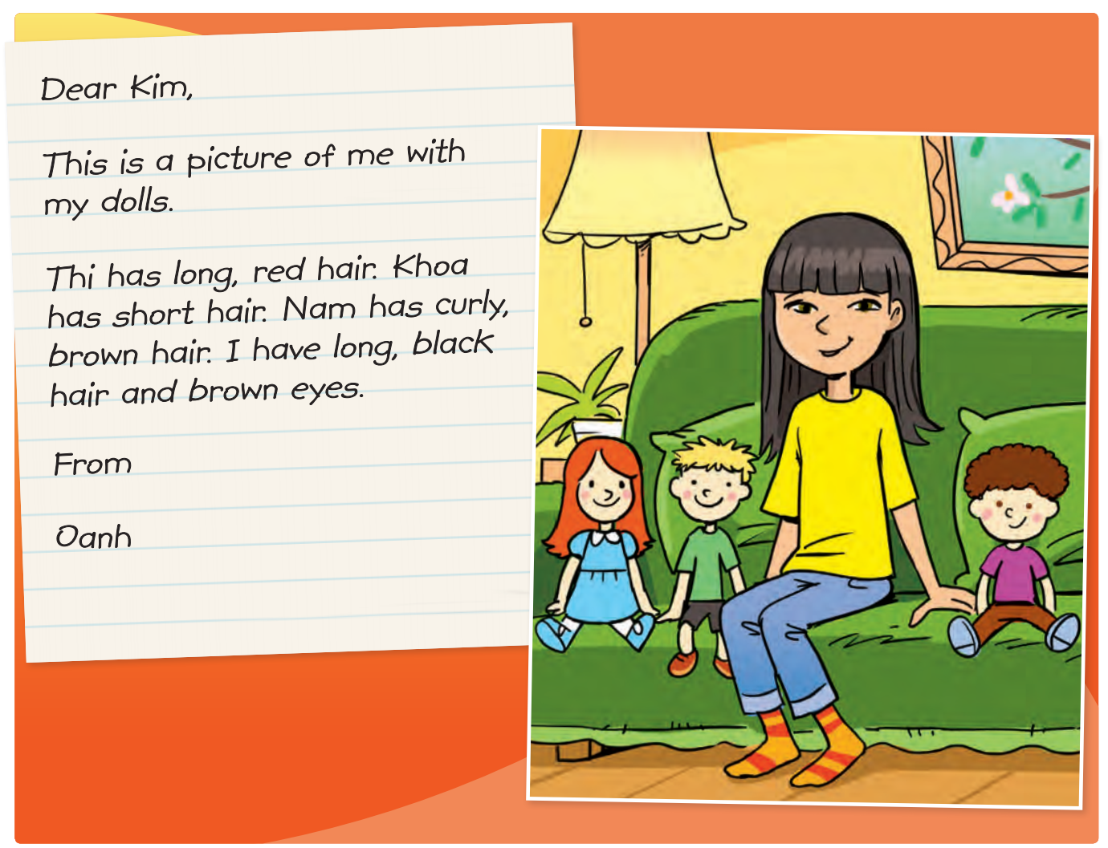
Look and Say
How many dolls can you see?

Slide 7

Listen and Point

Slide 8
Listen and Repeat

Slide 9
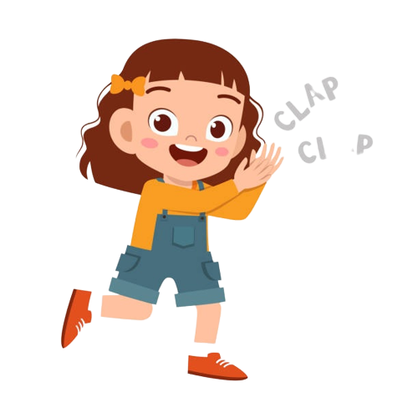
Good job!

Slide 10
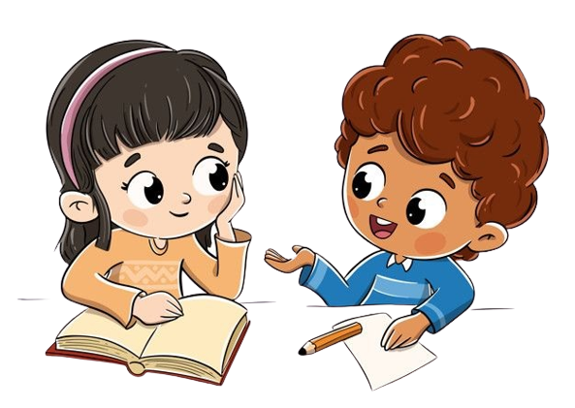
Work in Pairs
Take turns to read

Slide 11
Good job!

Slide 12
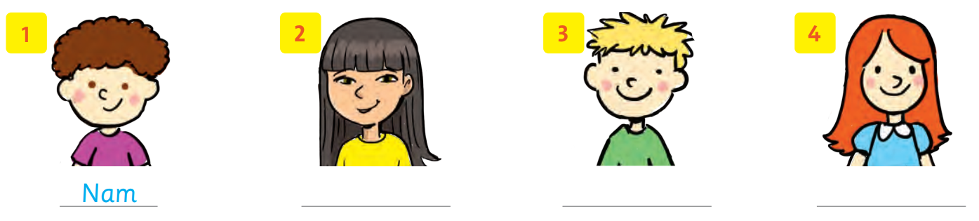
Read again and Write the names.
Oanh
Khoa
Thi

Slide 13
Good job!

Slide 14
Work in Pairs
Do you like doll?
What’s your favorite toy?

Slide 15
Good job!

Slide 16

Game

Slide 17
Good job!

Slide 18
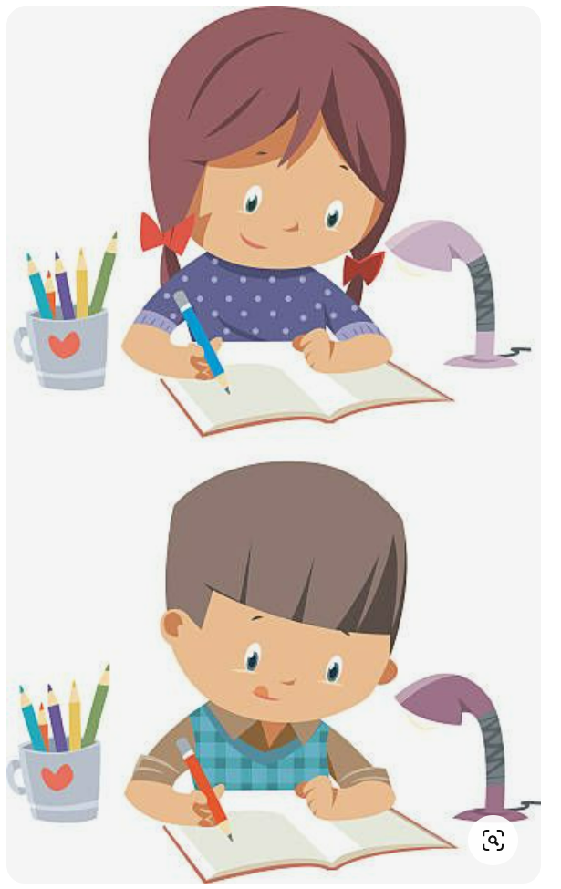
Homework

Slide 19


Goodbye!

